Slide 1
Project 9: EKF-based Localization with LRF
Presentation 4:
EKF Coding and Problems
Notes:
This is the fourth presentation about our project. Project number 9: Extended Kalman Filter based Localization using a Laser Range Finder

Slide 2
Outline
Progress
EKF
Raycasting
Outlook
Questions
Notes:
This is the outline of my presentation.
I am going to start with the progress we were able to achieve since the last lab. Therefore, I am going to talk about using the Gazebo environment for simulation purposes and the implementation of the EKF code in C++.
In the second part of the presentation I am going to give you a short outlook on our plan for the next weeks before finishing with questions we have right now.

Slide 3
Outline
Progress
EKF
Raycasting
Outlook
Questions
Notes:
So progress:

Slide 4
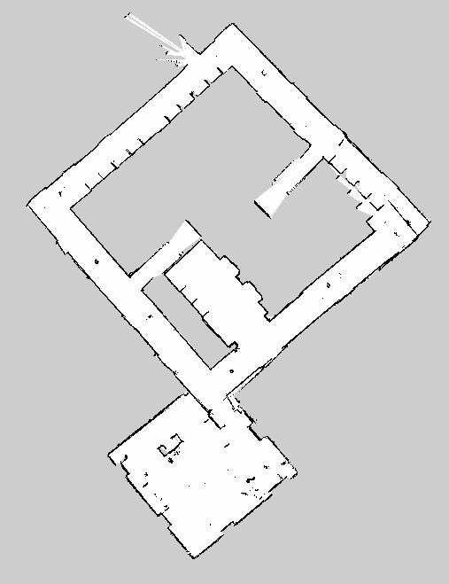
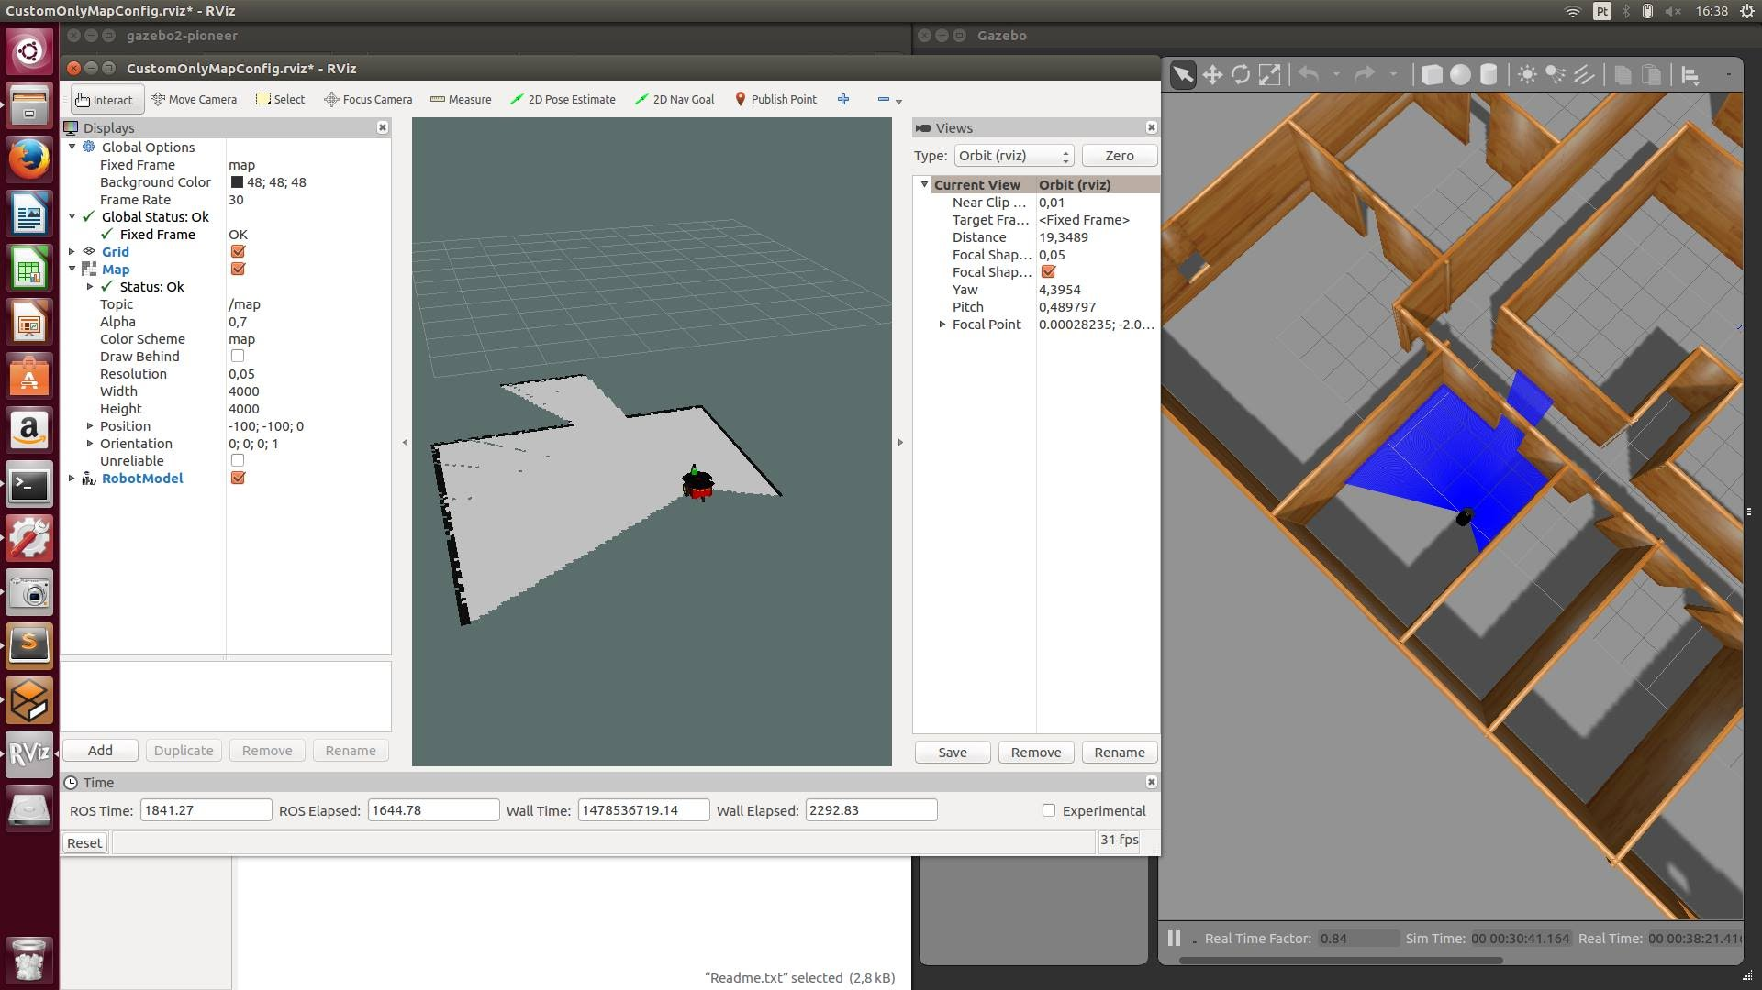
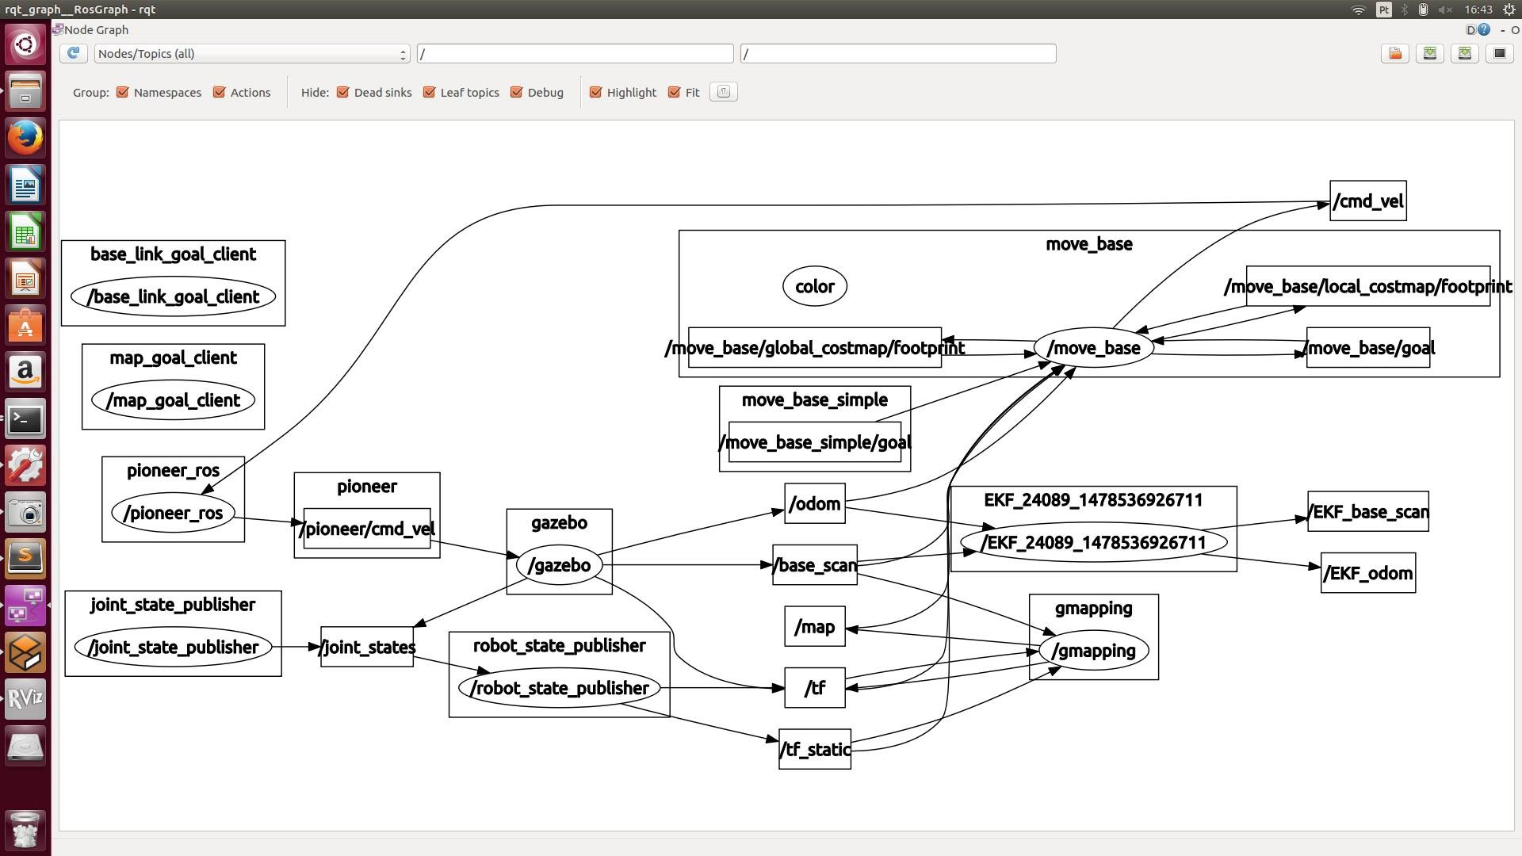
Progress (1)
2 weeks ago:
Improved map (using landmarks)
Preparation for implementation of EKF
Gazebo with world map, Pioneer 3DX and LRF
Publisher and subscriber python code
Notes:
This is a brief summary of what was our situation two weeks ago.
We had a more accurate map of the 5th floor, using some trash cans and backpacks as landmarks.
We were able to launch Gazebo. With a launch file which launches Gazebo with our map and our robot model with a laser
It also launches the Rviz with every needed topic just like we would do with the real robot.
We also wrote some python code for subscribing and publishing topics, but weren’t able to test it.
So what did we achieve in the last 2 weeks?

Slide 5

Progress (2)
Today:
Fully working simulation environment to test the code
EKF prediction code implementation (in C++)
Core code of EKF algorithm
State & Observation prediction
System Dynamics
Partial Derivatives
(Jacobian)
Covariance Matrix
Prediction
Not as much progress as planned!!
Notes:
We have a Fully Working Simulation Environment, with Gazebo, which is helping us test our code without using the real robot.
As you may have noticed from the previous slide, we already had some python code. This wasn’t functioning as expected, and we had a lot of trouble finding the error, so we cast it aside.
We also decided to do the code in C++, which is computionaly less expensive.
*CLICK*
We currently have the core Code for EKF, which consists in the system dynamics function, the Partial Derivatives, that corresponds to the Jacobian of the sd function, and the Covariance Matrix.
We also have implemented the code for the state and observation prediction, based on the Odometry and the Observation Model.
*CLICK*
This means, we already have the prediction part completely coded.
*CLICK*
Again, we didn’t progress as much as we wanted due to the problems that arose and the fact that there were some testes these weeks.

Slide 6
EKF
Notes:
f : next state prediction = current state prediction + change in odometry + noise ← accumulate less errors
F: It will be used in the state prediction0

Slide 7
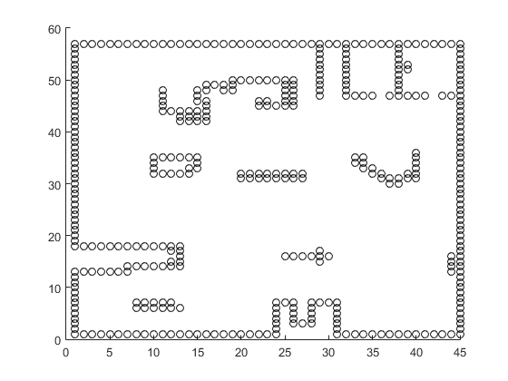
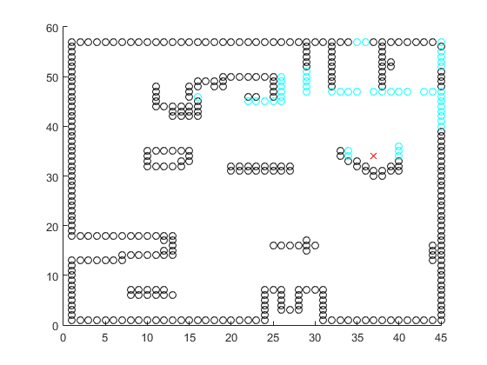
Raycasting
Matlab Simulation
Given Map
After Raycast
Notes:
Befor coding the raycasting algorithm on C++, we did a small simulation on Matlab.
The characteristics of the laser on this simulation weren’t exactly the same as the real laser.
Here we have the result of the simulation done in Matlab of the RayCasting Algorithm.
On the left we have a simple map created just to use as a simulation tool to test the algorithm.
On the right, we have the map with the overlaid laser scan, cyan, given a pose of the robot (represented by the red cross).

Slide 8
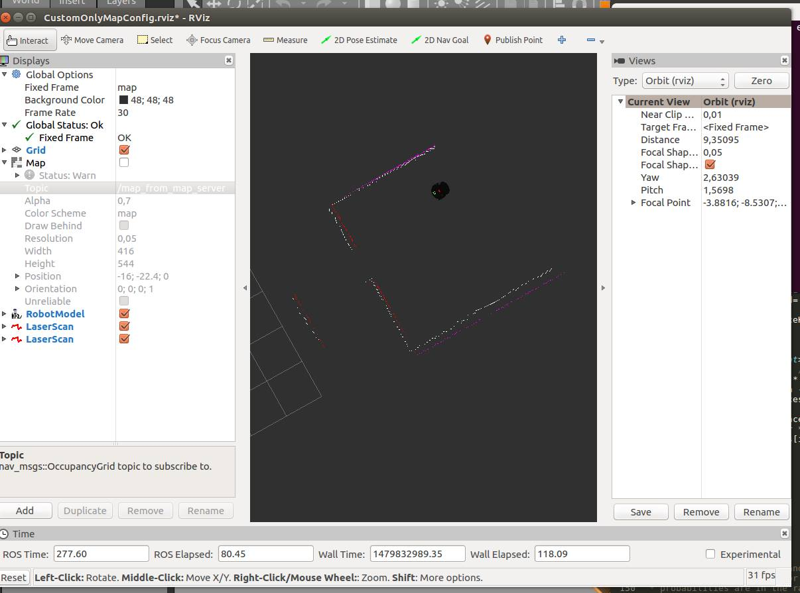
Raycasting
Simulation
Notes:
We then implemented the code in C++, which was a little bit simpler.
After that we used the simulation environment to simulate the robot’s behaviour.
In this picture we can see the predicted laser measurement (white dots), using the Raycasting algorithm, and the real laser measurement (simulated).
As we can see, the points almost overlap, and have very small deviation from the real measurement.
This means the algorithm is working, and the prediciton phase is done.

Slide 9
Outline
Progress
EKF
Raycasting
Outlook
Questions
Notes:
So how will we continue our work on the project?

Slide 10
Outlook
LRF
Work in progress!
Matching
Prediction
Update
Odometry
Observation model
Map
Based on the EKF localization slides
Notes:
Currently, we are working on the matching and the update parts. In comparison to the prediction part we expect the implementation to be less time consuming.
Because especially the update step only consists on formulas, for which we can already calculate every used variable.

Slide 11

Outlook
2 more weeks to ...
… implement matching and updating
… test code on the simulation
… test code on the real robot
… implement kidnapping robustness
LRF
Matching
Prediction
Update
Odometry
Observation model
Map
Based on the EKF localization slides
Notes:
Obviously we need to work very hard in the next two weeks, because there are a lot things to do
First we need to implement the matching and updating steps,
then we need to test our code first in simulation and then on the real robot. In the end we hope to be able to test our code against kidnapping and implement kidnapping robustness.
*CLICK*
All this within 2 weeks will probably end in a lot of night shifts.

Slide 12
Outline
Progress
EKF
Raycasting
Outlook
Questions
Notes:
We have a few questions for the teacher

Slide 13
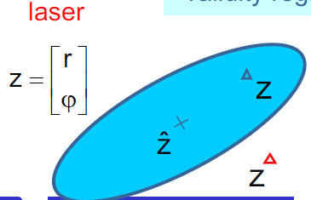
Questions
How do we find a good threshold for the matching part?

